Slide 1


Combating COVID-19 Outbreaks
WQD7005 Data Mining
Master of Data Science | University of Malaya
Part C: Processing of Data Assignment
Group Members:
Azwa bin Kamaruddin (WQD170089)
Kok Hon Loong (WQD170086)

Slide 2

Assignment Milestones
WQD7005 Data Mining | Semester 2 Session 2019/2020
Part A: (Group)
Web Crawling of Real-time Data
Part B: (Group)
Management of Data using Hadoop Data Warehouse or Data Lake
Part C: (Group)
Accessing and Processing of Data from Hadoop Data Warehouse or Data Lake using Python
Part D: (Individual)
Interpretation and Communication of Data Insights
Part E: (Group)
Deployment of the Data Mining Results on Web (Flask) and Mobile Application (Kivy)

Slide 3
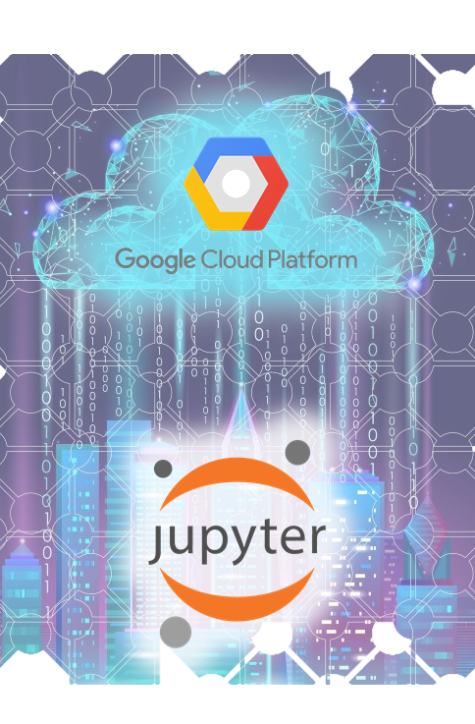
Assignment Background
From the previous assignment milestones, our group have accomplished the following tasks:
We have demonstrated our method in acquiring the near real-time data using the web crawling approach using Python programming and BeautifulSoup package.
Illustrating the steps in storing the data using cloud storage (a.k.a. data lake) and also to the Hadoop data warehouse leveraging on the DataProc configuration and implementation using Google Cloud Platform (GCP), which the data was then being accessed using Hive.
For this assignment milestone, our group will be focusing on the following:
Using Python that is coded on Jupyter Notebook web application in accessing the varieties of the stored data types (i.e. CSV, JSON) from the cloud storage.
Our group Python code is also uploaded in our group assignment GitHub at the link below:
https://github.com/scholarazwa/wqd7005-assignment

Slide 4
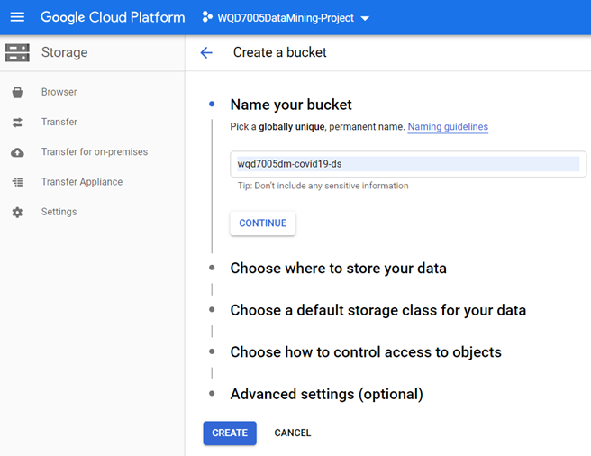
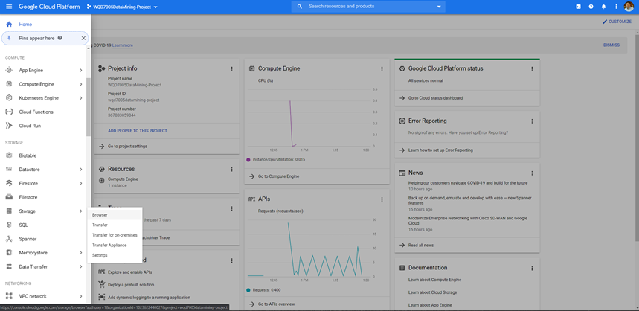
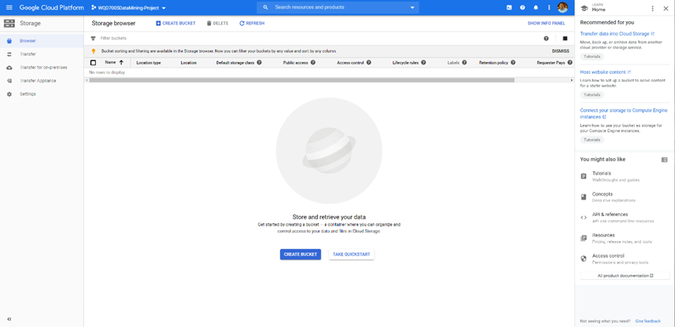
Accessing and Processing the Datasets creating Cloud Storage (Data Lake) in Google Cloud Platform (GCP)
Scroll to the Storage section in GCP Navigation menu, then click on Browser.
Click on Create Bucket, to create the storage container to store the data captured from web crawling.
Name the storage container as wqd7005dm-covid19-ds.

Slide 5
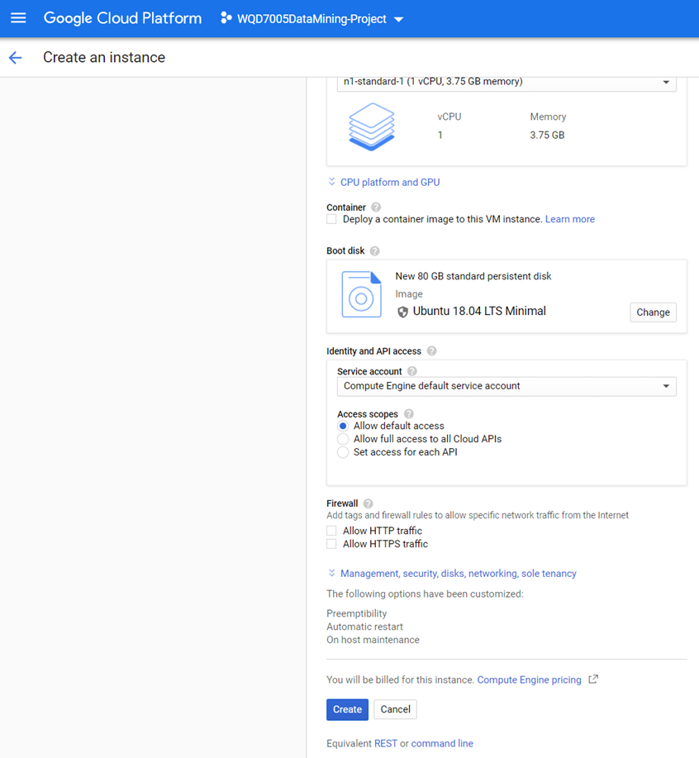
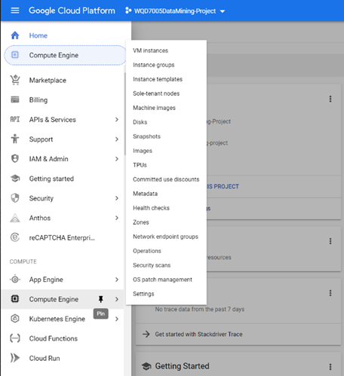
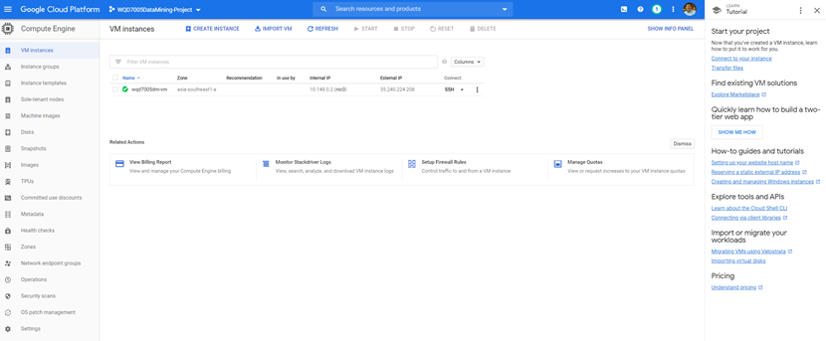
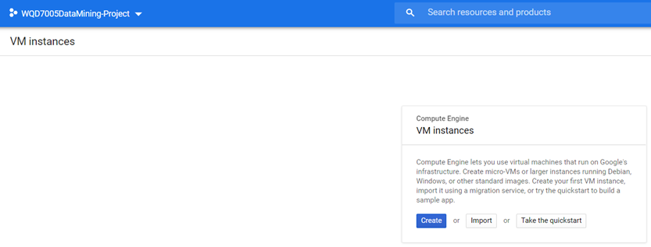
Accessing and Processing the Datasets creating Virtual Machine Instances in Google Cloud Platform (GCP)
In the Compute section, select Compute Engine and then click on VM instances.
Click on the Create button in the new pop-up window.
Use the minimal settings and named the VM instances as wqd7005dm-vm.
Our group chose to use Ubuntu as the OS with minimal setting. Then click on the Create button to provision the VM instances to install Anaconda with Jupyter Lab for Python.

Slide 6
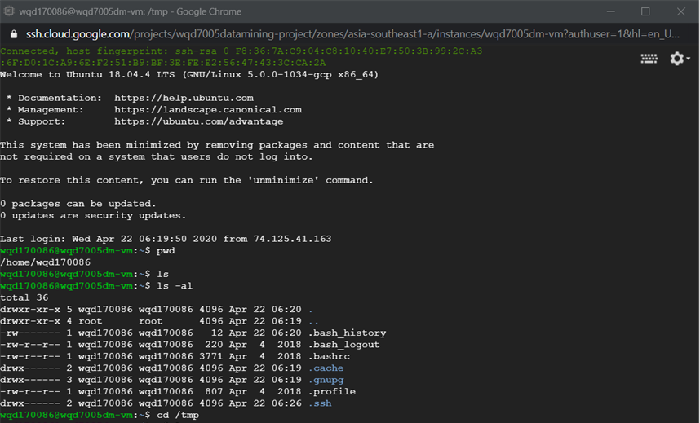

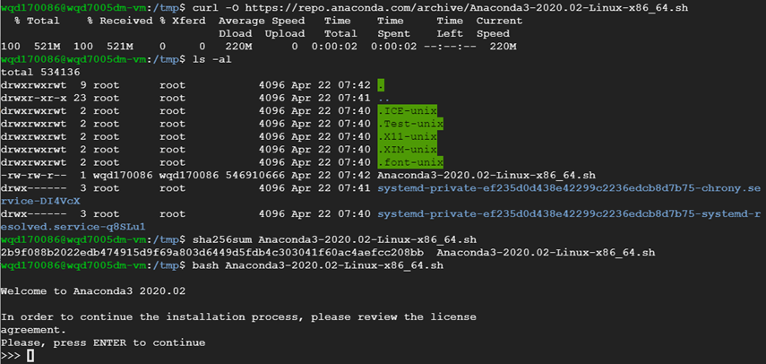
Accessing and Processing the Datasets installing Anaconda and Jupyter Lab in Google Cloud Platform (GCP) VM instances
Click on the SSH pull down menu, select Open in browser window.
The shell command prompt running on Ubuntu Linux will appear.
To install Anaconda, use the web browser to connect and view the Anaconda Distribution site @ https://www.anaconda.com/distribution/
Choose the latest Linux OS version and from the command prompt, type the following command to download the basch script: curl -O https://repo.anaconda.com/archive/Anaconda3-2020.02-Linux-x86_64.sh
Use the SHA-256 checksum command before running the Anaconda installation bash script.

Slide 7
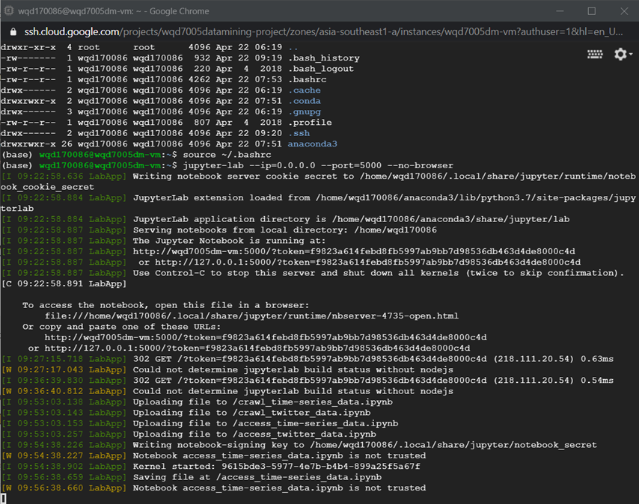
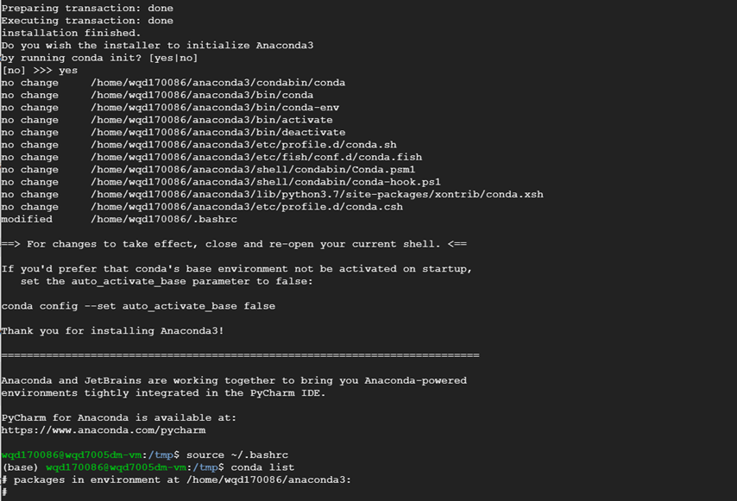
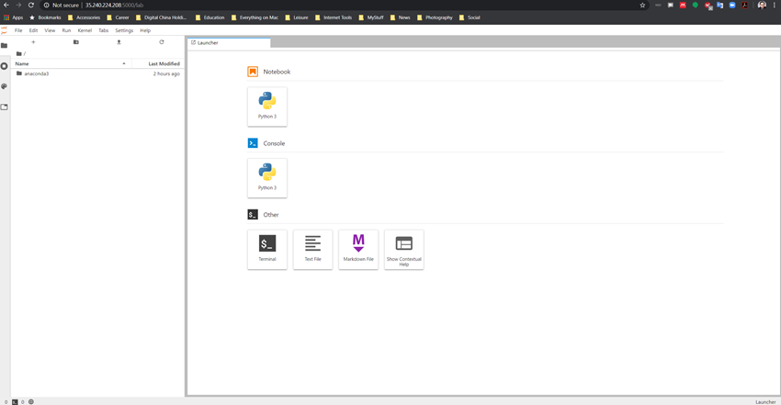
Accessing and Processing the Datasets to run Jupyter Lab in Google Cloud Platform (GCP) to start coding Python
To activate the installation, type source ~/.bashrc.
To test the installation and activation, type conda list.
Ensure to install the following packages if this is the first time running Anaconda and Jupyter Lab
To support importing storage in GCP: pip install --upgrade google-cloud-storage
To support importing Twitter module: pip install tweepy
To start Jupyter Lab from the Ubuntu command prompt (based on the port # set up during configuration), type jupyter-lab --ip=0.0.0.0 --port=5000 --no-browser
To access to the Jupyter Lab notebook, use a web browser to key in the token generated from the above command and the static IP address configures, i.e. http://<Static IP addr>:<Port #>/?token=f9823a614febd8fb5997ab9bb7d98536db463d4de8000c4d
Note: The token to use is different each time the jupyter lab is executed.

Slide 8
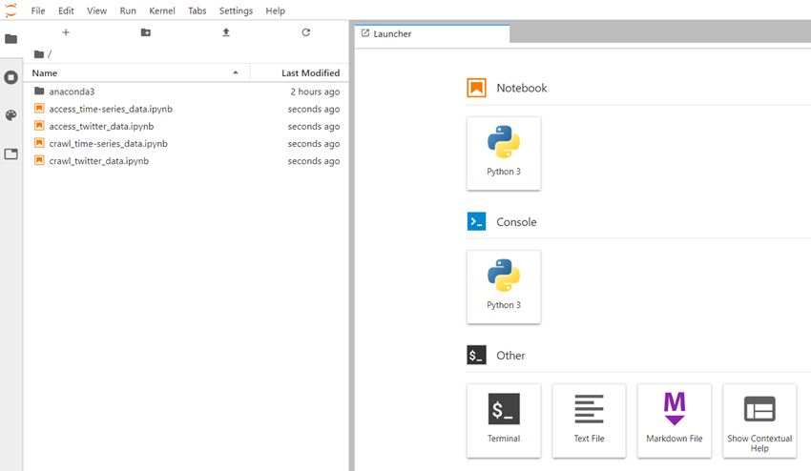
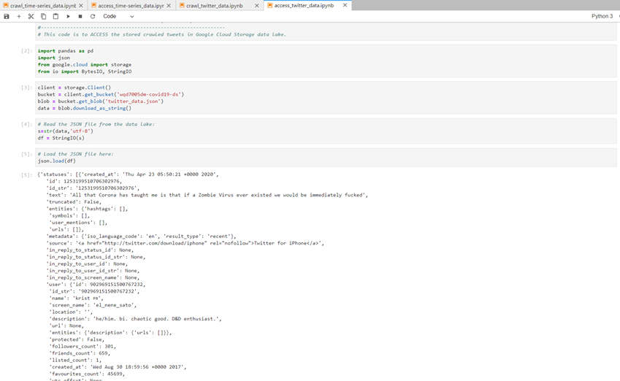
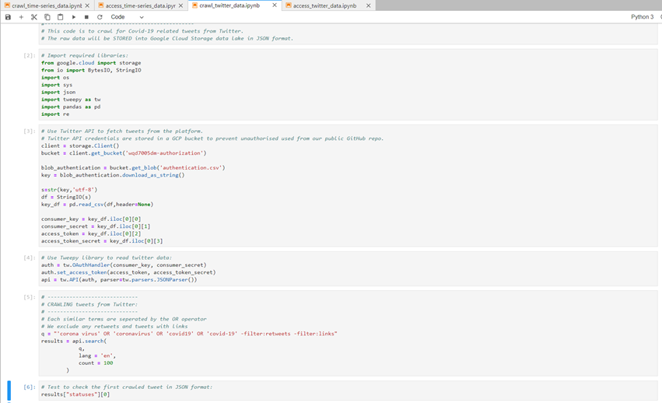
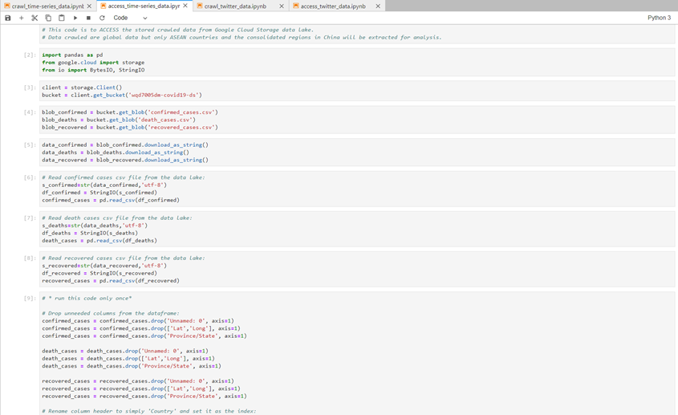
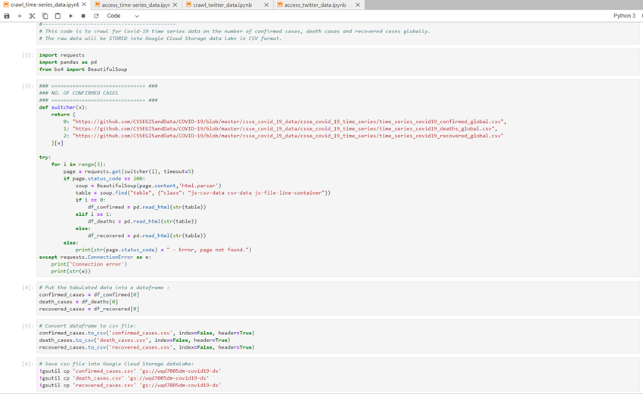
Accessing and Processing the Datasets using Python on Jupyter Lab notebook in Google Cloud Platform (GCP) VM instances
In this assignment, our group have created 4 sets of Python programming codes:
Crawl for time-series data (csv data sets)
Access time-series data
Crawl for Tweets from Twitter on relevant topics (json data set)
Access Tweets data
For this assignment, we have demonstrated the following:
Using web crawling method with Python codes to acquire varieties of data sets;
Accessing the data sets acquired using Python programming from our Cloud Storage (i.e. Data Lake)

Slide 9



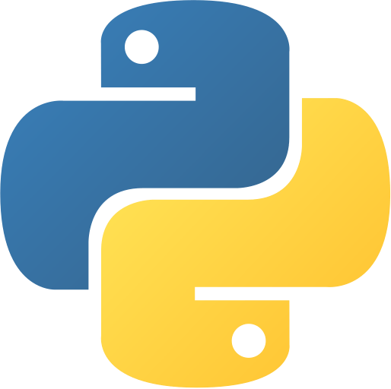
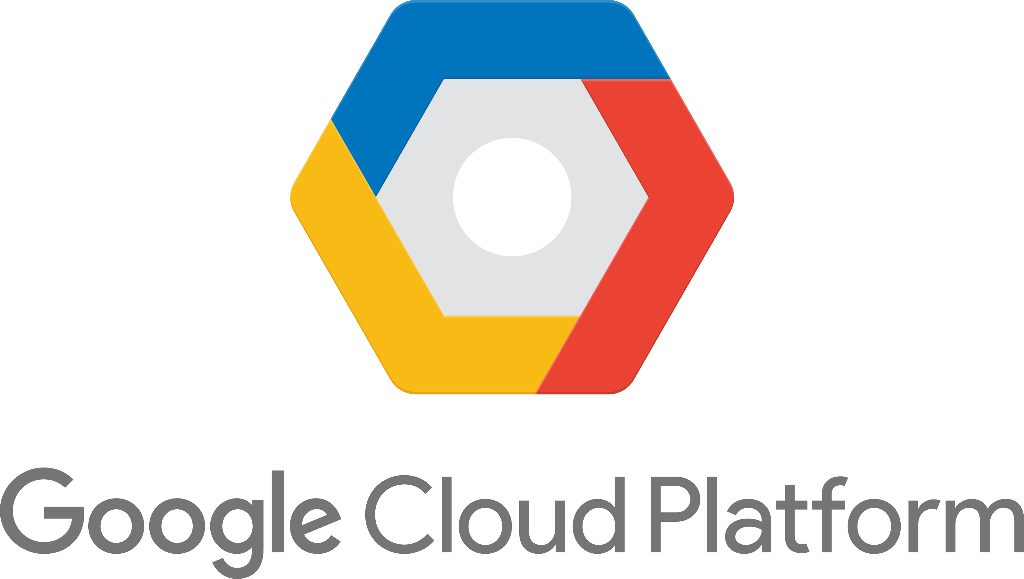
Summary
Data Acquisition & Exploratory Data Analysis
COVID-19 Time-series dataset (Confirmed, Recovered, Deaths)
COVID-19 related tweets (Timestamp, Location)
Within a typical data mining project, there are usually many different types of operations management software with many different data storage as well.
As the number of data sources multiplies, having data scattered all over in various formats prevents the data analysts from seeing the full and clear picture of their current state.
This creates the necessity for integrating data in a unified storage system where data is collected, reformatted, and ready for use.
Web Crawling
Near Real-time Datasets
Johns Hopkins University GitHub Repository
Twitter
Cloud Storage
Hadoop Data Warehouse

Slide 10

Thank You
Azwa Kamaruddin & Hon-Loong Kok (HL)

